Slide 1
Upper Midwest Grazing Educators Webinar Series
Integrating Livestock into Cropping Systems
August 7, 2015

Slide 2
Hosted by Warren King and Jane Jewett
Co-manager of the Pasture Project
President of WellSpring, Ltd
Work focused on expanding environmentally sustainable farming, developing local & regional food systems and improving water quality
Research Fellow, University of Minnesota
Green Lands Blue Waters Initiative

Slide 3
Webinar Technical Orientation
Notes:
Welcome! This is a quick overview of the basic features of the cluster call software.

Slide 4
Your Starting Screen
Presentation
Control Panel
Notes:
Your screen should look something like this.

Slide 5
To Display Minimized Control Panel
Click the orange arrow button
Notes:
You’ll want access to your control panel during the presentation, so if it is minimized, click the double arrow button.

Slide 6
To Keep Control Panel Visible
Notes:
To keep the control panel visible, go to the View menu …

Slide 7
To Ask a Question
Type your question in the small box at the bottom of the Questions box.
If possible, specify which panelist(s) you are addressing with your question.
Press “Send”!
Notes:
To interact with the panelist(s) or tech support, use the Questions box. Most questions will be addressed after the formal presentation during the Q&A time, but if you need clarification on a point, or have technical difficulties, ask at any time.

Slide 8
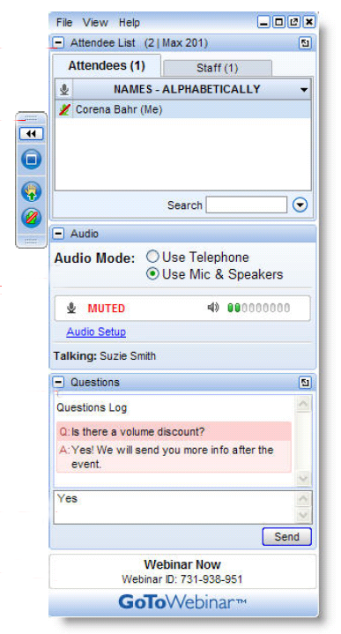
To “Raise Your Hand”
Notes:
To interact with the panelist(s) or tech support, use the Questions box. Most questions will be addressed after the formal presentation during the Q&A time, but if you need clarification on a point, or have technical difficulties, ask at any time.

Slide 9
Post-Webinar Survey
We will be sending out a survey following the webinar.
These surveys help to make for a better experience for everyone involved, if you could please take a moment to fill them out, it would be of great help to us.
Notes:
At the conclusion of the Cluster Call your browser will open showing a very brief survey. Please take a minute or two to fill it out so that we can continue to make the Cluster Calls a valuable service to you.

Slide 11
Who’s Sponsoring the webinar series?
Green Lands Blue Waters
The Pasture Project
Goals
Increase perennial forage and pasture
Improve environmental performance of farming
Maintain production and profitability
Goals
Expand grass-based livestock production
Accelerate transition to sustainable farm production
Improve water quality

Slide 12
Why Focus on Grazing Educators?
The Upper Midwest is a unique geography
More young farmers are interested in livestock production
More landowners and conservationist are interested in livestock benefits
More consumers want pasture raised meat and dairy products
Less public funding for grazing networks and education
Fewer professional development opportunities for educators
Changes in grazing techniques and terminology
No single source for education materials

Slide 13
What Could a Grazing Educator Network Achieve?
Connect Upper Midwest Educators through discussion and sharing
Assess education materials-tool; determine what’s missing and fill the gaps
Create a platform to house and access materials and tools
Share what works and why
Cross-pollination of staff, students, apprentices and programs
Involve established grazing education programs
Access materials-tools no longer in circulation
Build collaboration that is more “grass-roots” than “top-down”
Include educators of various types; farmers, academics, agency and consultants
Establish basic principles of managed grazing that are taught by all

Slide 14
What is the format for today’s webinar?
Presenters will discuss topics, sharing experience and insights
Audience is encouraged to do the same
Moderators will “direct the traffic” and keep discussion moving
Audience is asked to take a brief survey at the end of the webinar

Slide 15
H. Joe Sellers is an ISU Extension beef specialist working in Lucas County where he also is co-owner and partner in a farm operation.
Since 1987 he’s advised extension clients on grazing and beef and sheep management in southern Iowa.
He led the Chariton Valley Beef value-added beef initiative and several other custom grazing and forage demonstration projects supported by the Leopold Center.
His contributions have been recognized by county, state and national organizations. He served on the board of directors of the Iowa Forage and Grasslands Council and the South Central Iowa Area Partnership.
He has degrees in animal science and agricultural education and studies from Iowa State University.

Slide 16
Integrating livestock into cropping systems
Joe Sellers
Duane and Jodi Steenhoek

Slide 17
Midwest farms have combined pasture and row crops

Slide 18
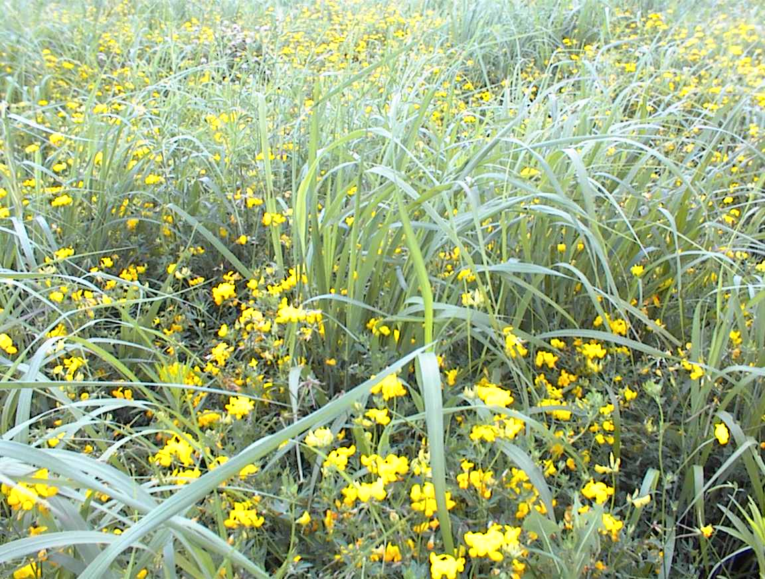
Where has all the pasture gone?
Notes:
Diverse mix of grasses and legumes

Slide 19
Iowa Beef Cow Herd (Number of Cows, USDA Census)
Notes:
The beef cow herd in Iowa has decreased over the years, along with the US herd. Beef cow numbers Jan 1 2014 were the same as the 2012 herd of 885,000.

Slide 20
Decline in cropable pasture (Acres, Census of Agriculture)
Notes:
Iowa has seen a dramatic decrease in “cropable pasture” acres devoted to pasture – there are only 10% of this type of pasture compared to 1997. This is over 3.2 million less tillable pasture acres compared to 1974.

Slide 21
Decline in Cropable Pasture in the Midwest (http://iopscience.iop.org/1748-9326/10/4/044003/)
2008-2012
Minnesota cropland was increased by 215,000 acres
Illinois by 81,000 acres
Wisconsin by 157,000 acres
Uncultivated Land pre-1970 converted to cropland between 2008-2012
In Minnesota, previously uncultivated land accounted for 22,000 acres converted to cropland
In Illinois, 8,800 acres
In Wisconsin, 14,000
Nationwide, grasslands account for 77% of all cropland conversions.
Data collected from “Cropland expansion outpaces agricultural and biofuel policies in the United States, Tyler J Lark et al 2015 Environ. Res. Lett.

Slide 22
Forage on the side hills, crops on the ridge

Slide 23
What led to less diversity?
1980’s Farm Crisis
Assets “walked off the farm to cover debt”
Loss of a generation with basic animal husbandry knowledge
USDA commodity programs and insurance subsidies
Aging farmer base
Capital requirements, price volatility

Slide 24
Corn and soybean rotation is not best use of some marginal soils (Iowa CSR2)
Notes:
Some farmland in Iowa converted from pasture to row crop has marginal productivity. These Clarinda and Shelby soils are examples of soils that fit crop, forage rotations or pastures better than continuous row crop.

Slide 25
Soil loss – corn/soybean rotation (RUSL2)
Notes:
These same soils result in much higher soil erosion potential – even with no-till in a corn soybean rotation.

Slide 26
Nothing compares to well managed pasture(RUSLE2)
Notes:
Soil erosion losses are 70-95% less with forage production.

Slide 27
Return to land (per acre), by corn yield, $3.50 per bushel harvest price (Land Use Analyzer)
Notes:
While corn production was profitable the past three years, lower returns are projected for 2014-2015.

Slide 28
Return to land, cow-calf (Projections, Ag DecisionMaker)
Notes:
Beefbasis.com projects fall prices for 550 lb steers in Iowa at $2.35. This would result in higher returns on a per cow or per acre basis.

Slide 29
ISU Extension and Outreach Land Use Analyzer
Look at productivity, soil erosion potential and economics of land use choices
Crop and livestock land use analyzer
http://www.extension.iastate.edu/agdm/wholefarm/html/c1-15.html
Land owners from other states can use the budget portions by entering their own yields, costs, etc.
Notes:
Survival of the fittest is not a management strategy. Many types of cattle can fit a grazing system. Try to mix working with nature to optimize grass production, with good cattle technologies we know will work.

Slide 30
Land Use Analyzer http://www.extension.iastate.edu/agdm/wholefarm/html/c1-15.htm

Slide 31
What factors are favoring more livestock/crop interaction?
Income potential of livestock, ability to spread risk
Added value opportunities, export expansion
Use of cover crops for soil benefits, potential livestock feed

Slide 32
Growth in deep bedded and pitted cattle feeding barns

Slide 33
Total Manure Nutrient Value Per Space (Iowa State University Feedlot Manual)
 | Volume | Total Value | Hauling Cost | Net per Yr
Open Lot | 3 tons | $35 | $15 | $20
Deep Bed | 5 tons | $76 | $25 | $51
Deep Pit | 2500 gal | $91 | $38 | $53
Notes:
Assumes 35% N available and $0.45 for N $0.55 for P2O5 and $0.45 for K2O hauling costs of $5/ton for dry and $0.015/gal for liquid.

Slide 34
Swine finishing units
Add income for farm operation without market risk
Utilize manure for crop operations
Different models – deep pit production, hoop barns

Slide 35
Best practices for grazing cornstalks
Strip graze for higher utilization, graze soon after harvest to get most quality
Move to fresh stalks, do not graze all winter
Graze with dry pregnant cows to reduce need for supplementation
Grazing crop residues with beef cattle (Nebraska)-
http://www.ianrpubs.unl.edu/live/ec278/build/ec278.pdf

Slide 36
Grazing or harvesting corn crop residue
Corn stover underutilized in Iowa
180 bushel corn per acre – 2880 lbs. husks and leaves, available to graze or harvest
Need cooperation between crop farmer and livestock owner
Research shows well managed grazing does not reduce subsequent yield
Harvesting requires replacing nutrients removed

Slide 37
Potential to graze or harvest cover crops
Need to balance agronomy and livestock nutrition goals
Most likely to get yields in spring on late summer/early fall cereal grains
Insurance, soil, agronomic and livestock interactions with harvest/grazing dates

Slide 38
Iowa producers looking for different cow-calf management systems
Extended grazing
Traditional 50/50 hay and graze
Limited grazing or drylot/confinement
New Leopold Cow Systems project

Slide 39
New project with Leopold Center -
Sustainably growing Iowa’s beef herds: Evaluating systems that provide economic opportunities while protecting soil and water resources
Limited grazing, traditional and extended grazing systems
Using benchmark data, we will analyze the environmental and economic sustainability of each model as well as the risk-bearing ability of each system. They will create case studies of practices for successful operations in each system for educational materials and a production manual for Iowa cow-calf producers.

Slide 40
Cows can graze high quality stockpile

Slide 41
Cows can graze late into the winter

Slide 42
Combination of stored feed and grazing

Slide 43
Calving and rearing calves inside

Slide 44
Good environment for cows and calves

Slide 45
Drylot production – Nebraska research

Slide 46
Value Added Markets
Sustainable beef –
Different definitions by suppliers - animal handling, feeding and land use keys
“Never ever 3” – no implant, antibiotics, ionophores – growing markets, export
High quality and branded programs
Increased 400% since 2003, approaching $4 billion per year (grain fed)

Slide 47
Growing grass fed, organic and direct to consumer markets
Total of organic, grass fed and natural about 5% of US market
Demand growing and expanding into traditional wholesale and retail markets
Need to be sure animal production and premium pay for system

Slide 48
Steenhoek Farms – Duane, Jodi, Sawyer, Sydney and Blair

Slide 49
Northwest corner of Lucas county
Diversified family farm (by any definition!)
425 cow-calf pairs, split between spring and fall calving cows
Finish half of those calves out and buy another 100 steers each year to feed
900 acres of corn, soybeans and oats
Nearly 600 acres of hay
Custom feed breeding gilts for a family from Minnesota

Slide 50
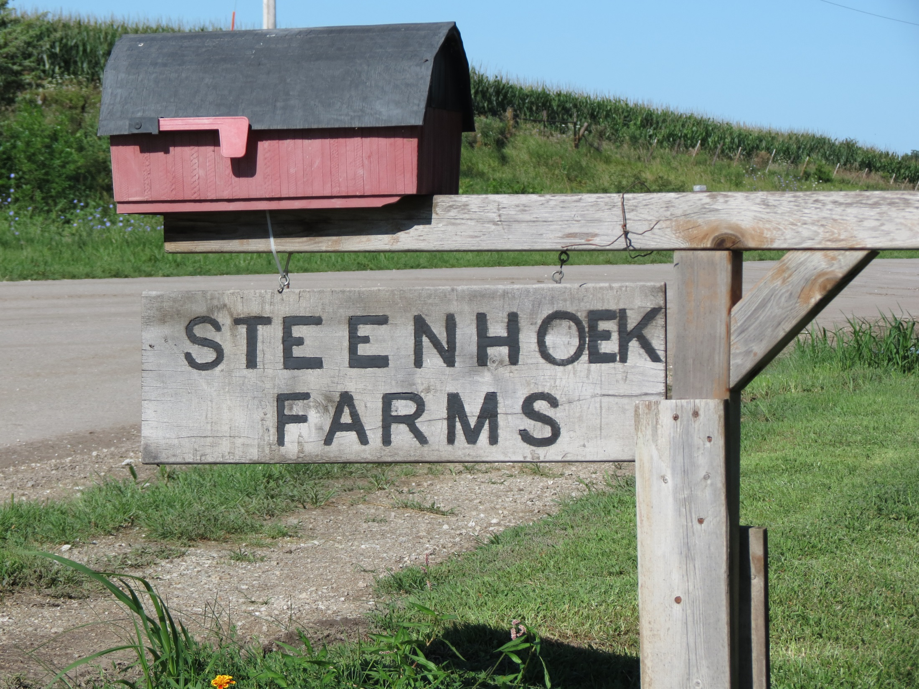

Slide 51
Background
Duane (Ag Studies) and Jodi (Elementary Education) are graduates of Iowa State University
Married 24 years
Children Sawyer (20), Sydney (17) and Blair (14)

Slide 52
Rotate pastures, fertilize with manure – nearly double stocking rate

Slide 53
Charolais-cross calves deal with the fescue better

Slide 54
Facilities
40 by 210 deep bedded hoop barn, 50% concrete
Swine are fed in three nurseries and a tunnel ventilated deep pit finishing barn

Slide 55
Hoop barn – better environment for calves, catch manure nutrients

Slide 56
Swine custom feeding – adds income and nutrients

Slide 57
Cattle and swine manure key to success

Slide 58
Built the hog buildings to get the manure to help build the fertility and tilth of the heavy clay soils we have on our farm
Field where the hog building site is located
20 years ago - 75 bushel corn
2014 - Chopped corn silage – yielded 198 bu/ac grain and 23.5 ton per acres of silage
Manure replaced commercial fertilizer and increases production

Slide 59
Productive crop fields

Slide 60
Swine manure
Hog finishing building - covered nearly 180 acres of pasture with 2500 gallons per acre.
Use a product called More Than Manure to stabilize the nitrogen and phosphorus
The manure from the cattle building is also spread on crop ground and pasture

Slide 61
Plant diversity with more rotational acres and saved pastures

Slide 62
Cover crops
Use cereal grains (rye) on corn silage ground
Plant annuals on prevented planting acres
Trying different mixes

Slide 63
Steenhoek Family

Slide 64
Discussion between Jodi, Duane and Joe
What are biggest challenges you face?
What is your dream for the future of your farm?
What technologies will you need to use to stay competitive?
How do you view the farming opportunities with livestock and crops in the future?

Slide 65
Cow herd is expanding – how do we keep profitable?

Slide 66
What could the impact be of more diversity?
Decreased soil erosion
Improved water quality
Balance risk with more income streams

Slide 67
How do diversified crop/livestock systems affect soil erosion and leachable nitrogen at a landscape scale?
Shelby County, Iowa

Slide 68
Watersheds with headwaters in Crawford and Shelby Counties, IA
Burkart et al. (2005)
Journal of Geophysical Research-Biogeosciences 110:
G01009, doi:10.1029/2004JG000008

Slide 69
Two scenarios
Current conditions for crops, non-agricultural vegetation, cattle, and hogs
Alternative conditions comprising more land in oat, forages, riparian buffers and eco-reserves; decreased land in corn and soybean; increased cattle (1.5x) and hogs (8x); no synthetic N fertilizer

Slide 70
Existing and alternative land use patterns, western Iowa

Slide 71
Predicted soil erosion, via WEPP model,
for current (A) and alternative (B) land uses in western Iowa
(“T” < 11.3 Mg ha⁻¹ yr⁻¹)

Slide 72
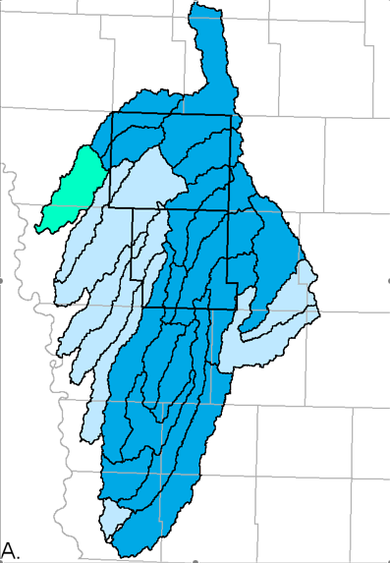
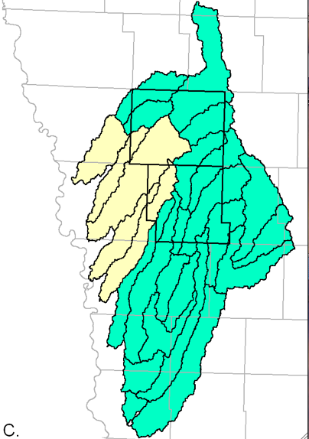
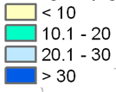
Predicted leachable soil nitrate-N concentrations for current and alternative land uses in western Iowa
NO₃-N, kg/ha
Current conditions
Diversified and
integrated crop-
livestock systems
Median: 32 kg NO₃-N/ha
Median: 10 kg NO₃-N/ha

Slide 73
Cow calf systems use forages from marginal soils

Slide 74
Questions???
Iowa Beef Center
iowabeefcenter.org
Joe Sellers
641-203-1270
sellers@iastate.edu

Slide 75
Future Webinars

Slide 76
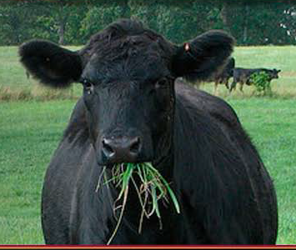
Thank you!

